Slide 1
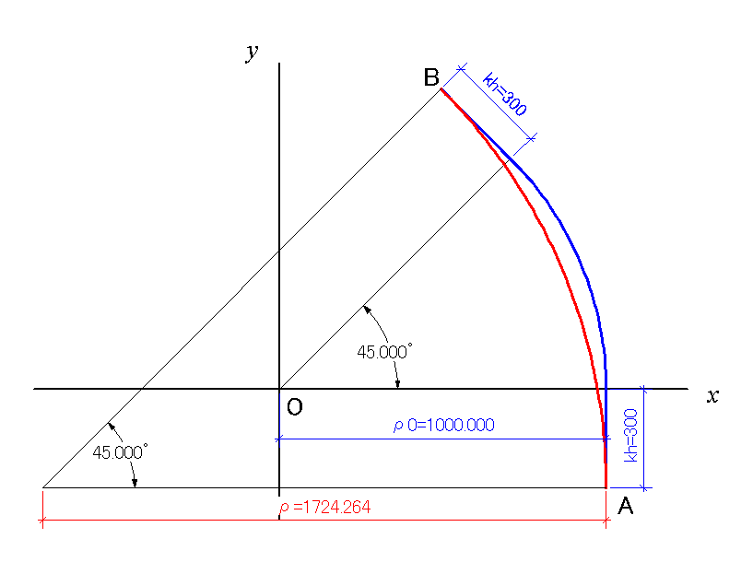
Rough Estimation of Path Length Difference
Position of Point B（Origin: Point O）
d
Red：with taking account of fringe fields
(1)
Blue：without taking account of fringe fields
(2)
ρ₀=1 m
d
ρ=1.0724264 m
(1)=(2) →
Path Length
Difference of path lengths(independent of ρ₀）
Red：with taking account of fringe fields
Blue：without taking account of fringe fields
d≈0.03m (half of magnetic gap) → ΔL=3.49 mm
Consistent with Opera result ΔL=4mm

