Slide 1
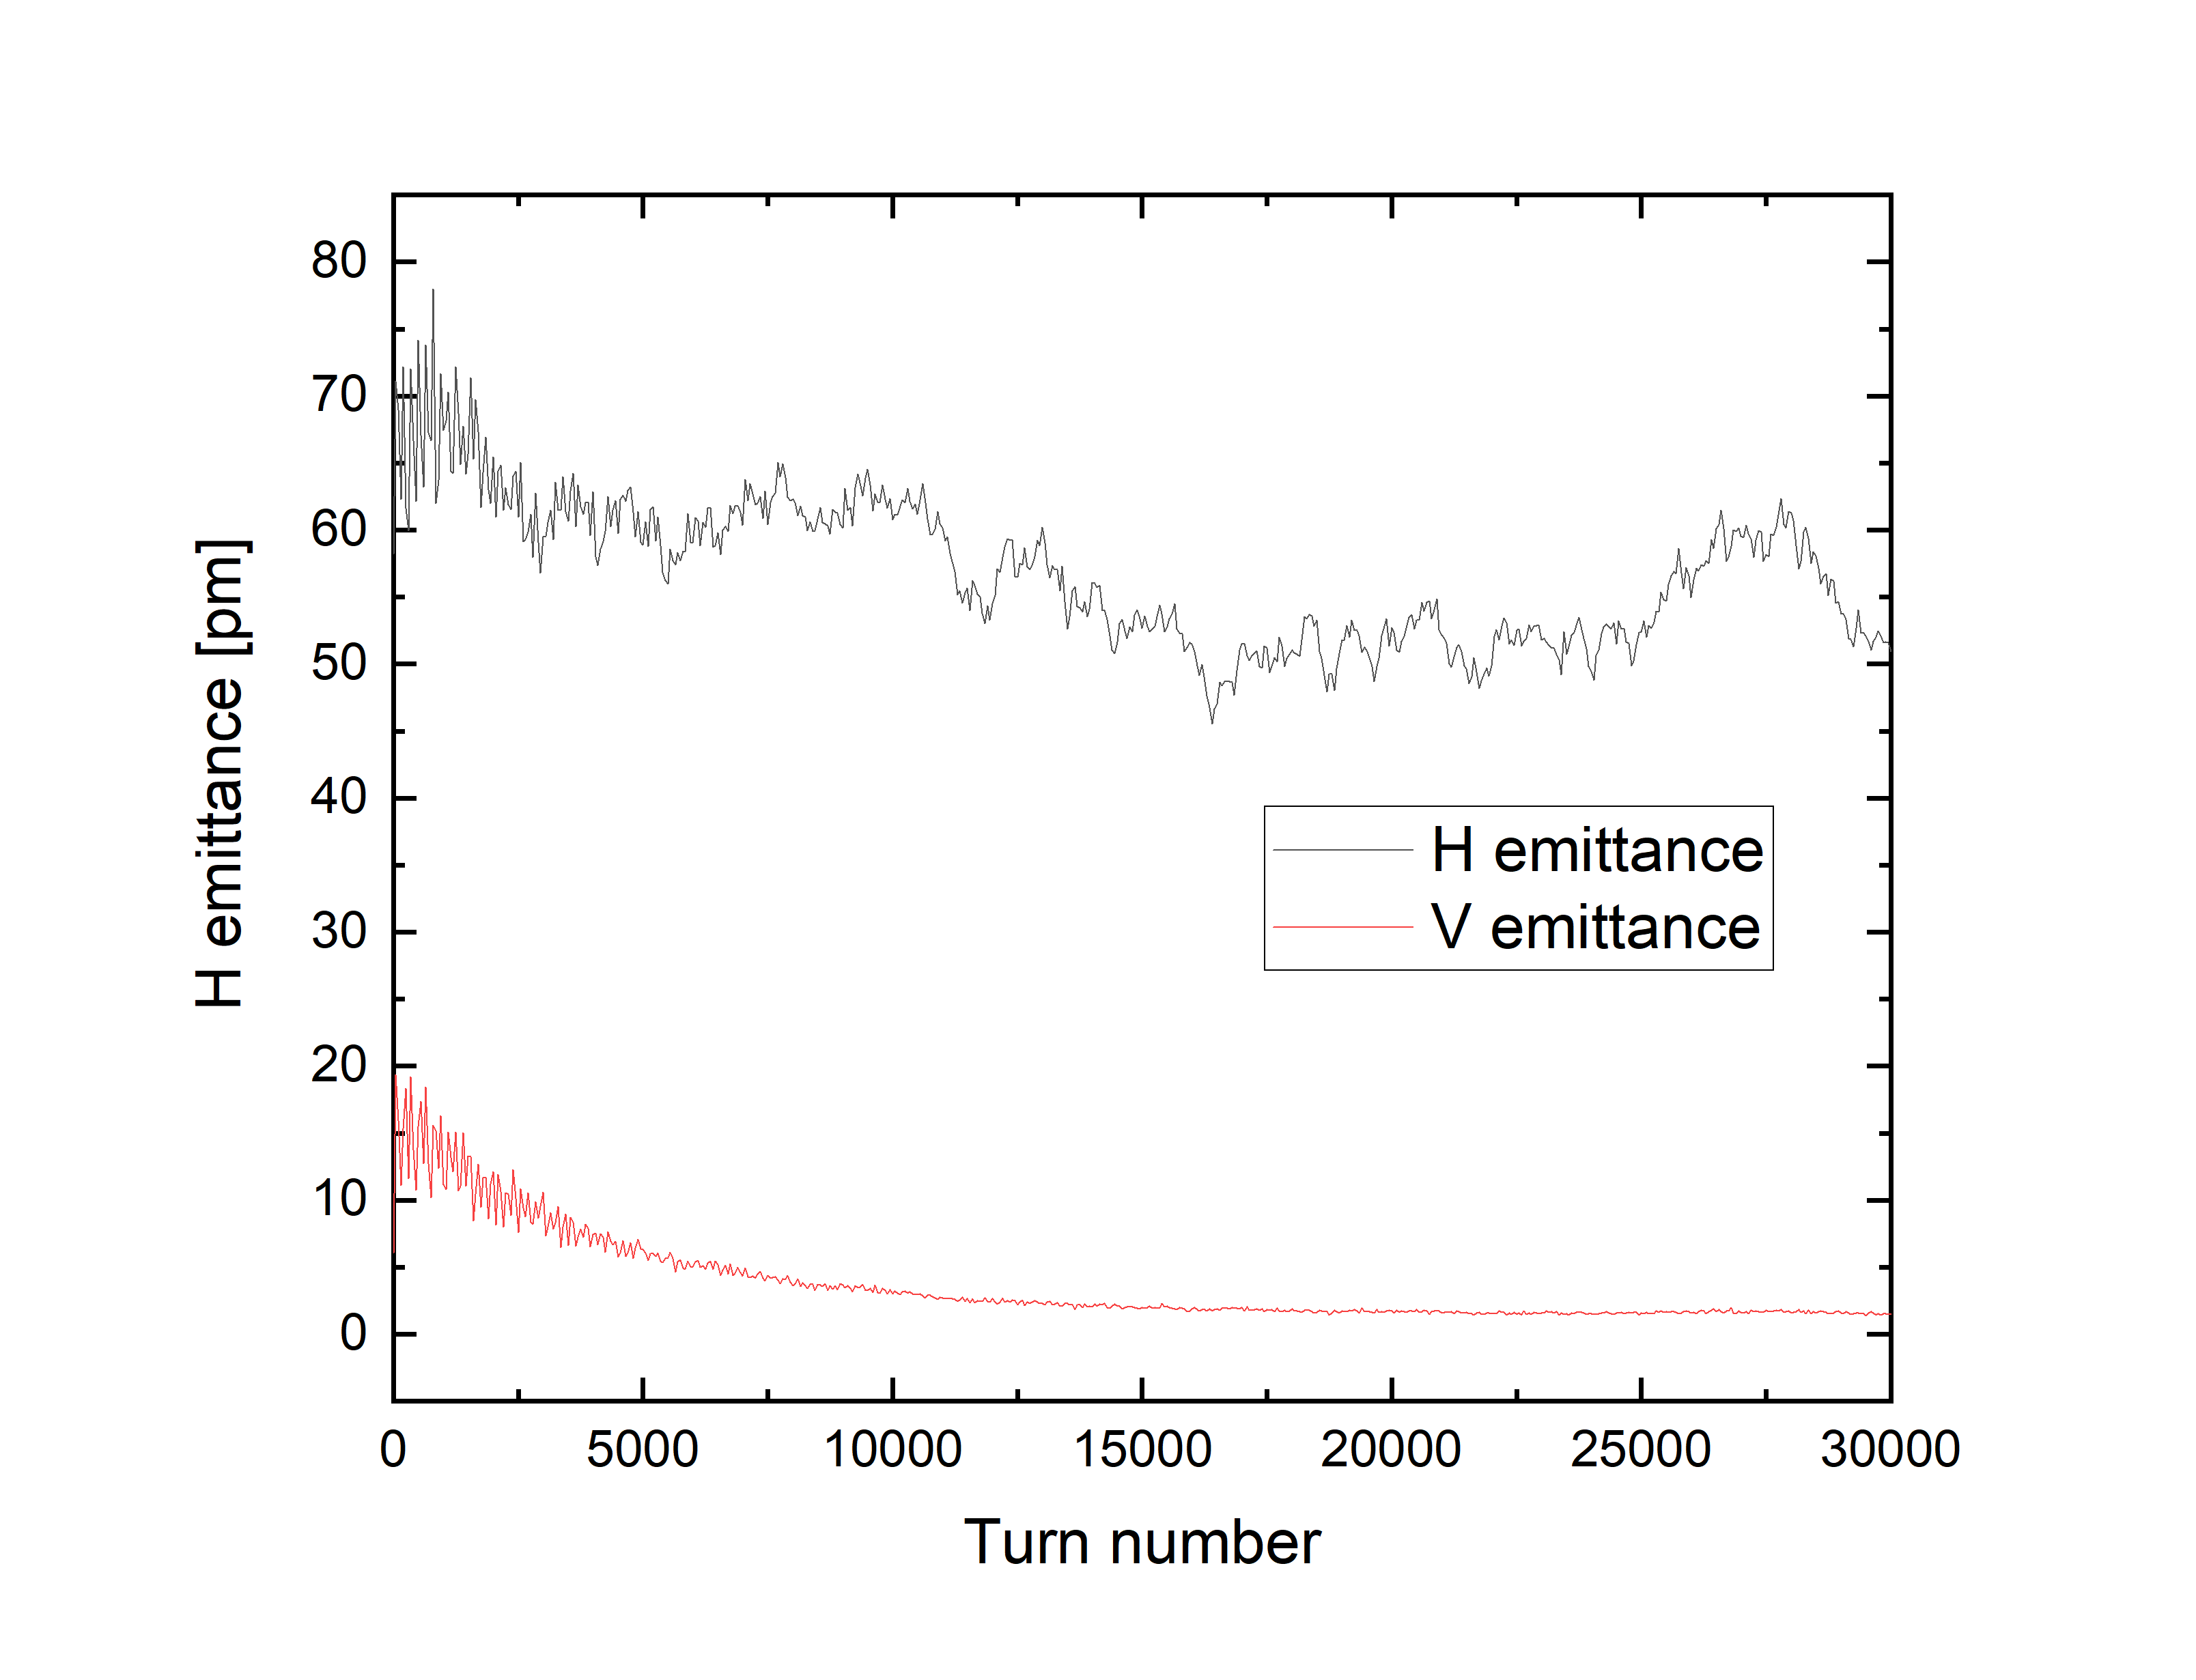
We put 12 skew quadrupoles with at lte file as below and adjust tunes in order to make full coupling beam
QS31A : KQUAD, L = 0.250000, K1 = 0.030, N_KICKS=20, TILT = 0.7853981633974479
QS32A : KQUAD, L = 0.250000, K1 = 0.030, N_KICKS=20, TILT = 0.7853981633974479
QS33A : KQUAD, L = 0.250000, K1 = 0.030, N_KICKS=20, TILT = 0.7853981633974479
QS31B : KQUAD, L = 0.250000, K1 = 0.030, N_KICKS=20, TILT = 0.7853981633974479
QS32B : KQUAD, L = 0.250000, K1 = 0.030, N_KICKS=20, TILT = 0.7853981633974479
QS33B : KQUAD, L = 0.250000, K1 = 0.030, N_KICKS=20, TILT = 0.7853981633974479
QS31C : KQUAD, L = 0.250000, K1 = 0.030, N_KICKS=20, TILT = 0.7853981633974479
QS32C : KQUAD, L = 0.250000, K1 = 0.030, N_KICKS=20, TILT = 0.7853981633974479
QS33C : KQUAD, L = 0.250000, K1 = 0.030, N_KICKS=20, TILT = 0.7853981633974479
QS31D : KQUAD, L = 0.250000, K1 = 0.030, N_KICKS=20, TILT = 0.7853981633974479
QS32D : KQUAD, L = 0.250000, K1 = 0.030, N_KICKS=20, TILT = 0.7853981633974479
QS33D : KQUAD, L = 0.250000, K1 = 0.030, N_KICKS=20, TILT = 0.7853981633974479
We checked coupling coefficient is close to one as below .
couplingIntegral 6.959754783793667e-03
couplingDelta 9.320972046111820e-05
emittanceRatio 9.998206684736263e-01
We track 240 particles and we get horizontal and vertical emittance variation.
We think that betatron coupling doesn't happen although we make coupling coefficient be one.

Slide 2
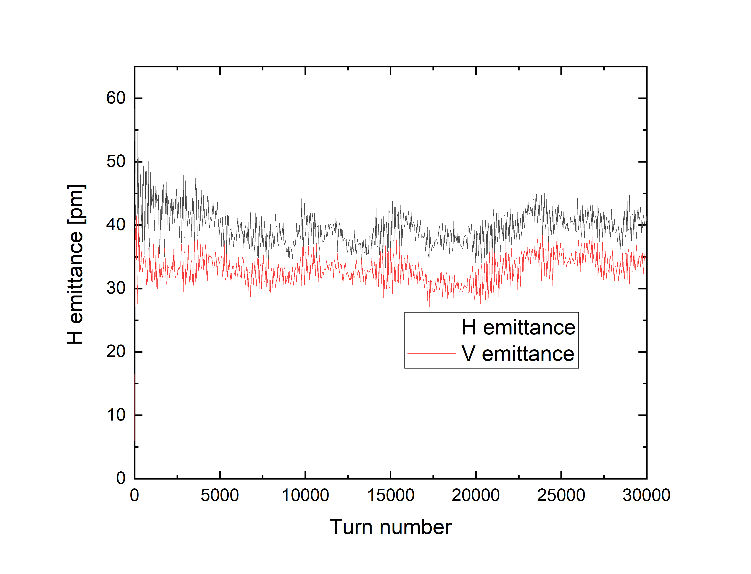
We put quadrupole tilt errors at ele fiel as belo.
&error_element name="q11", item="tilt", amplitude=0.5e-3, type="gaussian", cutoff=2.0, bind=0, fractional=0 &end
&error_element name="q12", item="tilt", amplitude=0.5e-3, type="gaussian", cutoff=2.0, bind=0, fractional=0 &end
&error_element name="q31", item="tilt", amplitude=0.5e-3, type="gaussian", cutoff=2.0, bind=0, fractional=0 &end
&error_element name="q32", item="tilt", amplitude=0.5e-3, type="gaussian", cutoff=2.0, bind=0, fractional=0 &end
&error_element name="q51", item="tilt", amplitude=0.5e-3, type="gaussian", cutoff=2.0, bind=0, fractional=0 &end
&error_element name="q52", item="tilt", amplitude=0.5e-3, type="gaussian", cutoff=2.0, bind=0, fractional=0 &end
We track 240 particles and we get horizontal and vertical emittance variation.
We think that betatron coupling happens because of quadrupole tilts.
The twi file shows us full coupling occurs by putting skew quadrupoles and adjusting tunes.
However, Emittance ratio obtained by beam tracking shows inconsistent result.

